Slide 1
Securing understanding of place value in metric units
Place value

Slide 2
how to use Oak lessons

Slide 3
I can convert statements about measure.

Slide 4
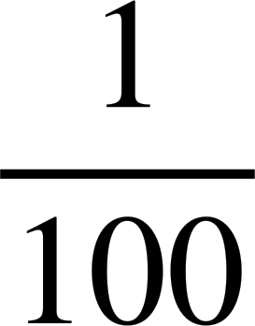
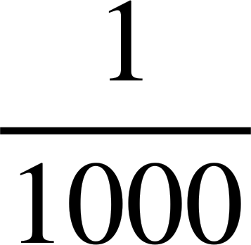
Metric units are based around the standard units of metre, gram and litre.
A prefix is a group of letters attached to the front of a root (word) to make a new word, for example tricycle.
Centi placed before a unit means
Milli placed before a unit means
Kilo placed before a unit means 1000 times.

Slide 5

Securing understanding of place value in metric units
Convert metric measures using place value
Use conversion to compare different measures
Check if conversions of real examples are sensible

Slide 6













Convert metric measures using place value
How would you use this place value chart to convert 12 m into cm?
= 1 2 0 0 cm
ones digit
unit
100 000 | 10 000 | 1000 | 100 | 10 | metres
 |  |  |  |  | metres
 |  | kilo |  |  | metres |  | centi | milli
1
2
0
0
.
describes longer distances
describes shorter distances

Slide 7
Convert metric measures using place value
How would you use this place value chart to convert 7.5 kg into grams?
= 7 5 0 0 g
ones digit
unit
Keyword check
kilogram means 1000 grams.
= 7500 g
7.5 kg means 7.5 lots of 1000 g
 |  |  |  |  | grams
 |  | kilo |  |  | grams |  | centi | milli
7
5
0
0
.
describes greater mass
describes smaller mass

Slide 8
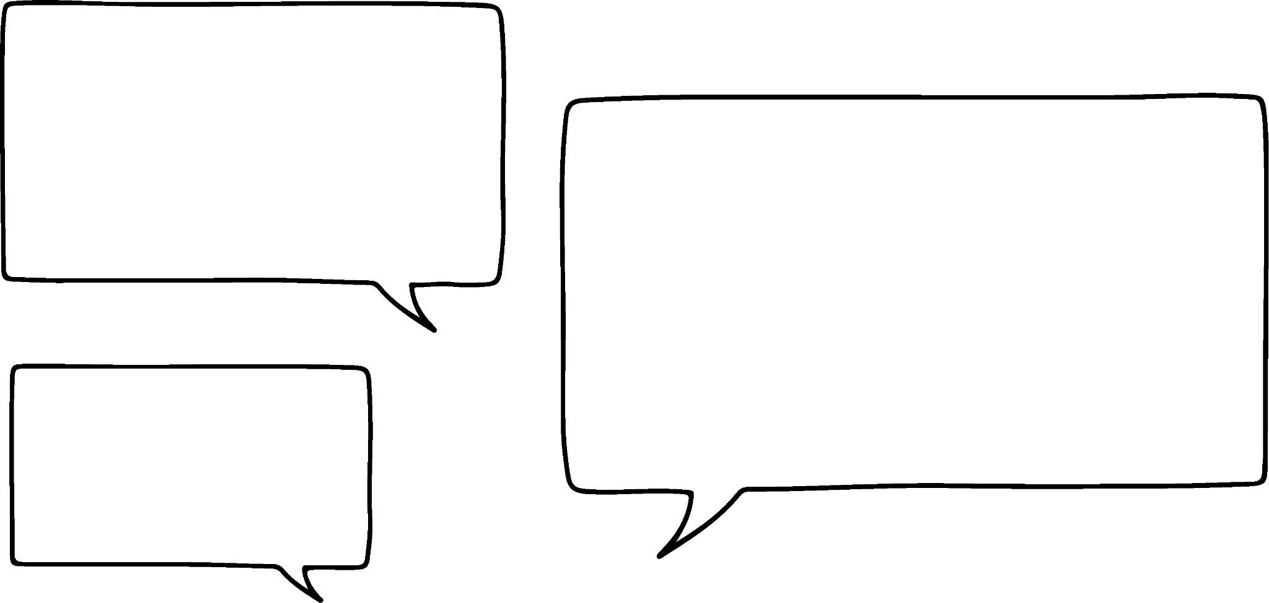

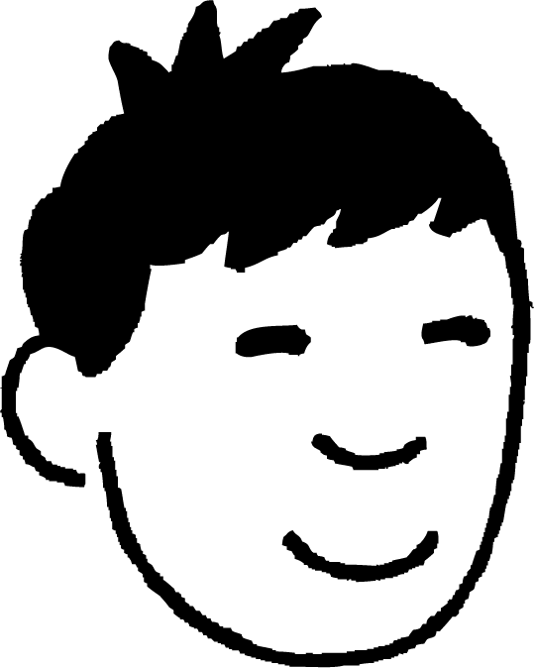

Convert metric measures using place value
Complete Jun’s sentence.
If I convert 0.47 litres into millilitres, I get .
a
0.470 ml
b
0470 ml
c
047.0 ml
d
470 ml
 |  |  |  |  | litres
 |  | kilo |  |  | litres |  | centi | milli
0
4
7
0
.
describes larger capacities
describes smaller capacities

Slide 9
Convert metric measures using place value
How would you use this place value chart to convert 6050 ml into litres?
= 6 . 0 5 litres
 |  | kilo |  |  | litres |  | centi | milli
6
.
0
5
0
describes larger capacities
describes smaller capacities

Slide 10


Convert metric measures using place value
How would you use this place value chart to convert 6050 ml into litres?
= 6 . 0 5 litres
Keyword check
millilitre means of a litre.
6050 ml means of a litre
= 6.05 litres

Slide 11
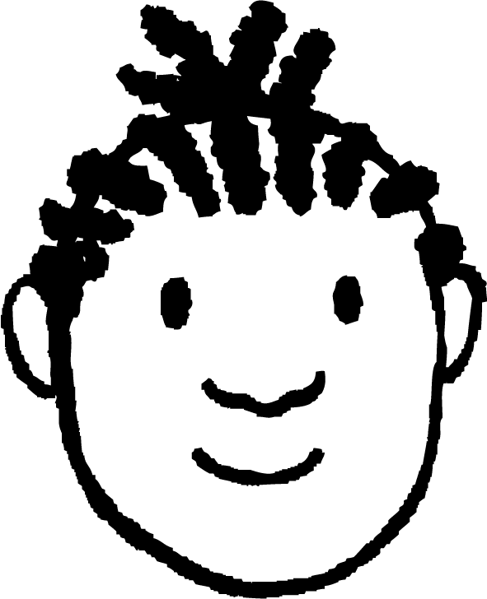
Convert metric measures using place value
Complete Jacob’s sentence.
I have a bottle of water that says 660 ml.
This is the same as .
a
0.66 m
b
0.66 litres
c
6.6 litres
d
0.660 litres
 |  | kilo |  |  | litres |  | centi | milli
0
.
6
6
0
describes larger capacities
describes smaller capacities

Slide 12
Convert metric measures using place value
1) Convert 7 km into:
a) metres
b) centimetres
c) millimetres
 | kilo |  |  | metres |  | centi | milli
2) Convert 425 ml into litres.
 |  | kilo |  |  | litres |  | centi | milli

Slide 13
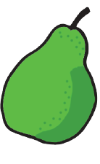
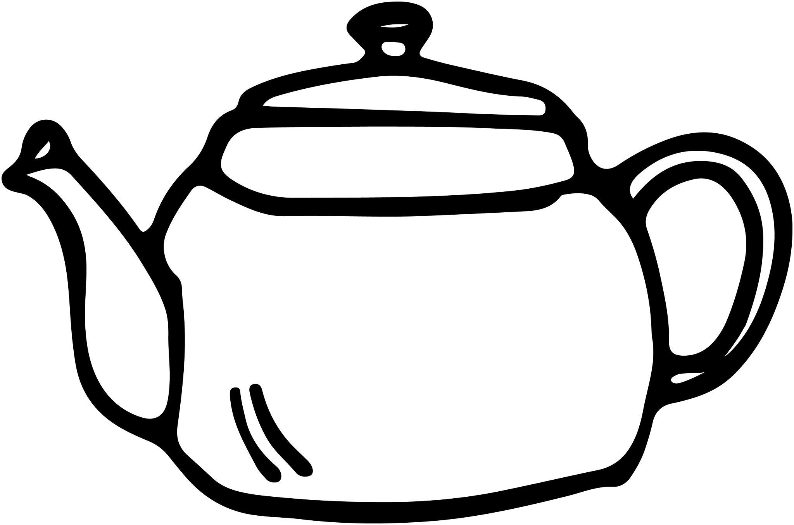
Convert metric measures using place value
3) What is the mass of this pear in kilograms?
163 g
4) What is the capacity of this teapot in ml?
1.15 litres

Slide 14
Convert metric measures using place value
1) Convert 7 km into:
a) metres
b) centimetres
c) millimetres
 | kilo |  |  | metres |  | centi | milli
 | 7 | 0 | 0 | 0
7 000 m
2) Convert 425 ml into litres.
 |  | kilo |  |  | litres |  | centi | milli

Slide 15
Convert metric measures using place value
1) Convert 7 km into:
a) metres
b) centimetres
c) millimetres
 | kilo |  |  | metres |  | centi | milli
 | 7 | 0 | 0 | 0 | 0 | 0
700 000 cm
2) Convert 425 ml into litres.
 |  | kilo |  |  | litres |  | centi | milli

Slide 16
Convert metric measures using place value
1) Convert 7 km into:
a) metres
b) centimetres
c) millimetres
 | kilo |  |  | metres |  | centi | milli
 | 7 | 0 | 0 | 0 | 0 | 0 | 0
7 000 000 mm
2) Convert 425 ml into litres.
 |  | kilo |  |  | litres |  | centi | milli

Slide 17
Convert metric measures using place value
1) Convert 7 km into:
a) metres
b) centimetres
c) millimetres
 | kilo |  |  | metres |  | centi | milli
 | 7 | 0 | 0 | 0 | 0 | 0 | 0
7 000 000 mm
2) Convert 425 ml into litres.
 |  | kilo |  |  | litres |  | centi | milli
 |  |  |  |  | 0 | 4 | 2 | 5
.
0.425 litres

Slide 18
Convert metric measures using place value
3) What is the mass of this pear in kilograms?
 |  | kilo |  |  | grams |  | centi | milli
 |  | 0 | 1 | 6 | 3
.
163 g
0.163 kg
4) What is the capacity of this teapot in ml?
 |  | kilo |  |  | litres |  | centi | milli
 |  |  |  |  | 1 | 1 | 5 | 0
1.15 litres
1150 ml

Slide 19
Securing understanding of place value in metric units
Convert metric measures using place value
Use conversion to compare different measures
Check if conversions of real examples are sensible

Slide 20
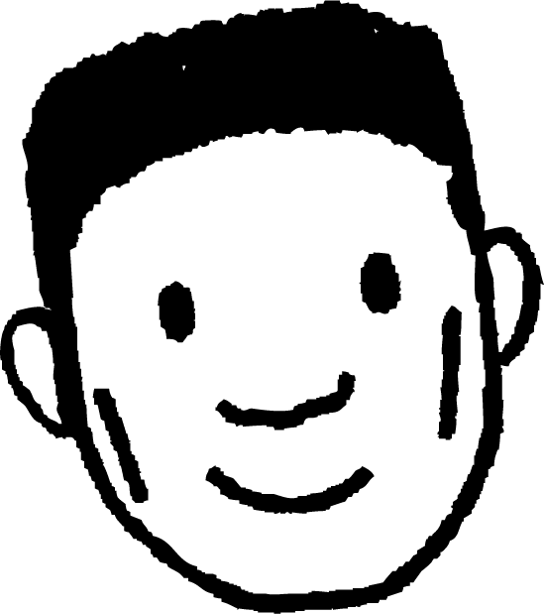
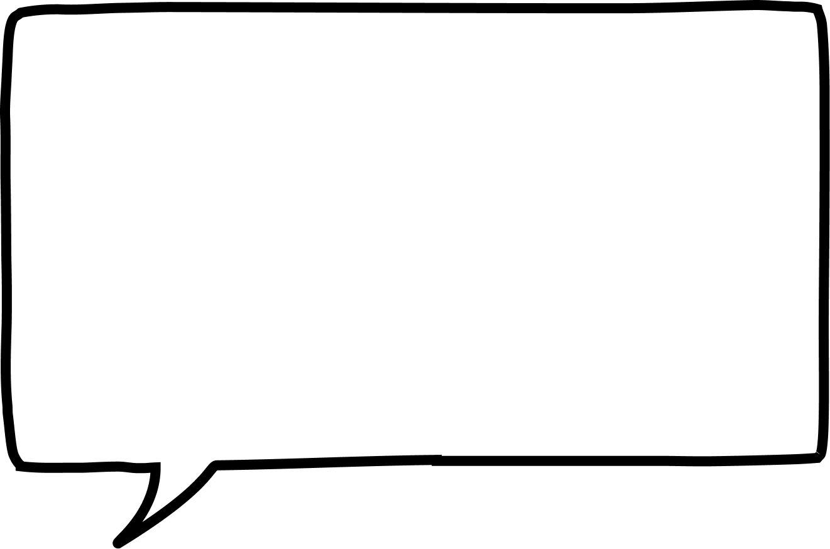
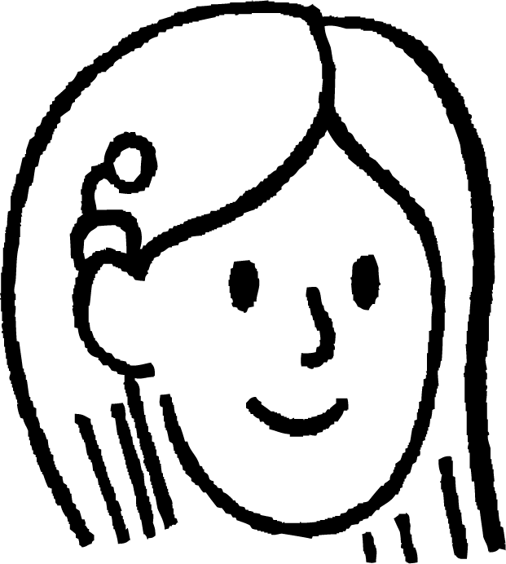

Use conversion to compare different measures
I walked 1.2 km to school today!
I walked 850 m to school today!
Lucas
Sofia
Who walked a further distance to school today?
Kilometre means 1000 m.
Convert km into m.
Convert m into km.
1.2 km means 1.2 lots of 1000 m.
850 m means of a km.
Lucas travelled 1200 m and Sofia travelled 850 m.
Sofia travelled 0.85 km and Lucas travelled 1.2 km.
Lucas travelled further than Sofia.

Slide 21
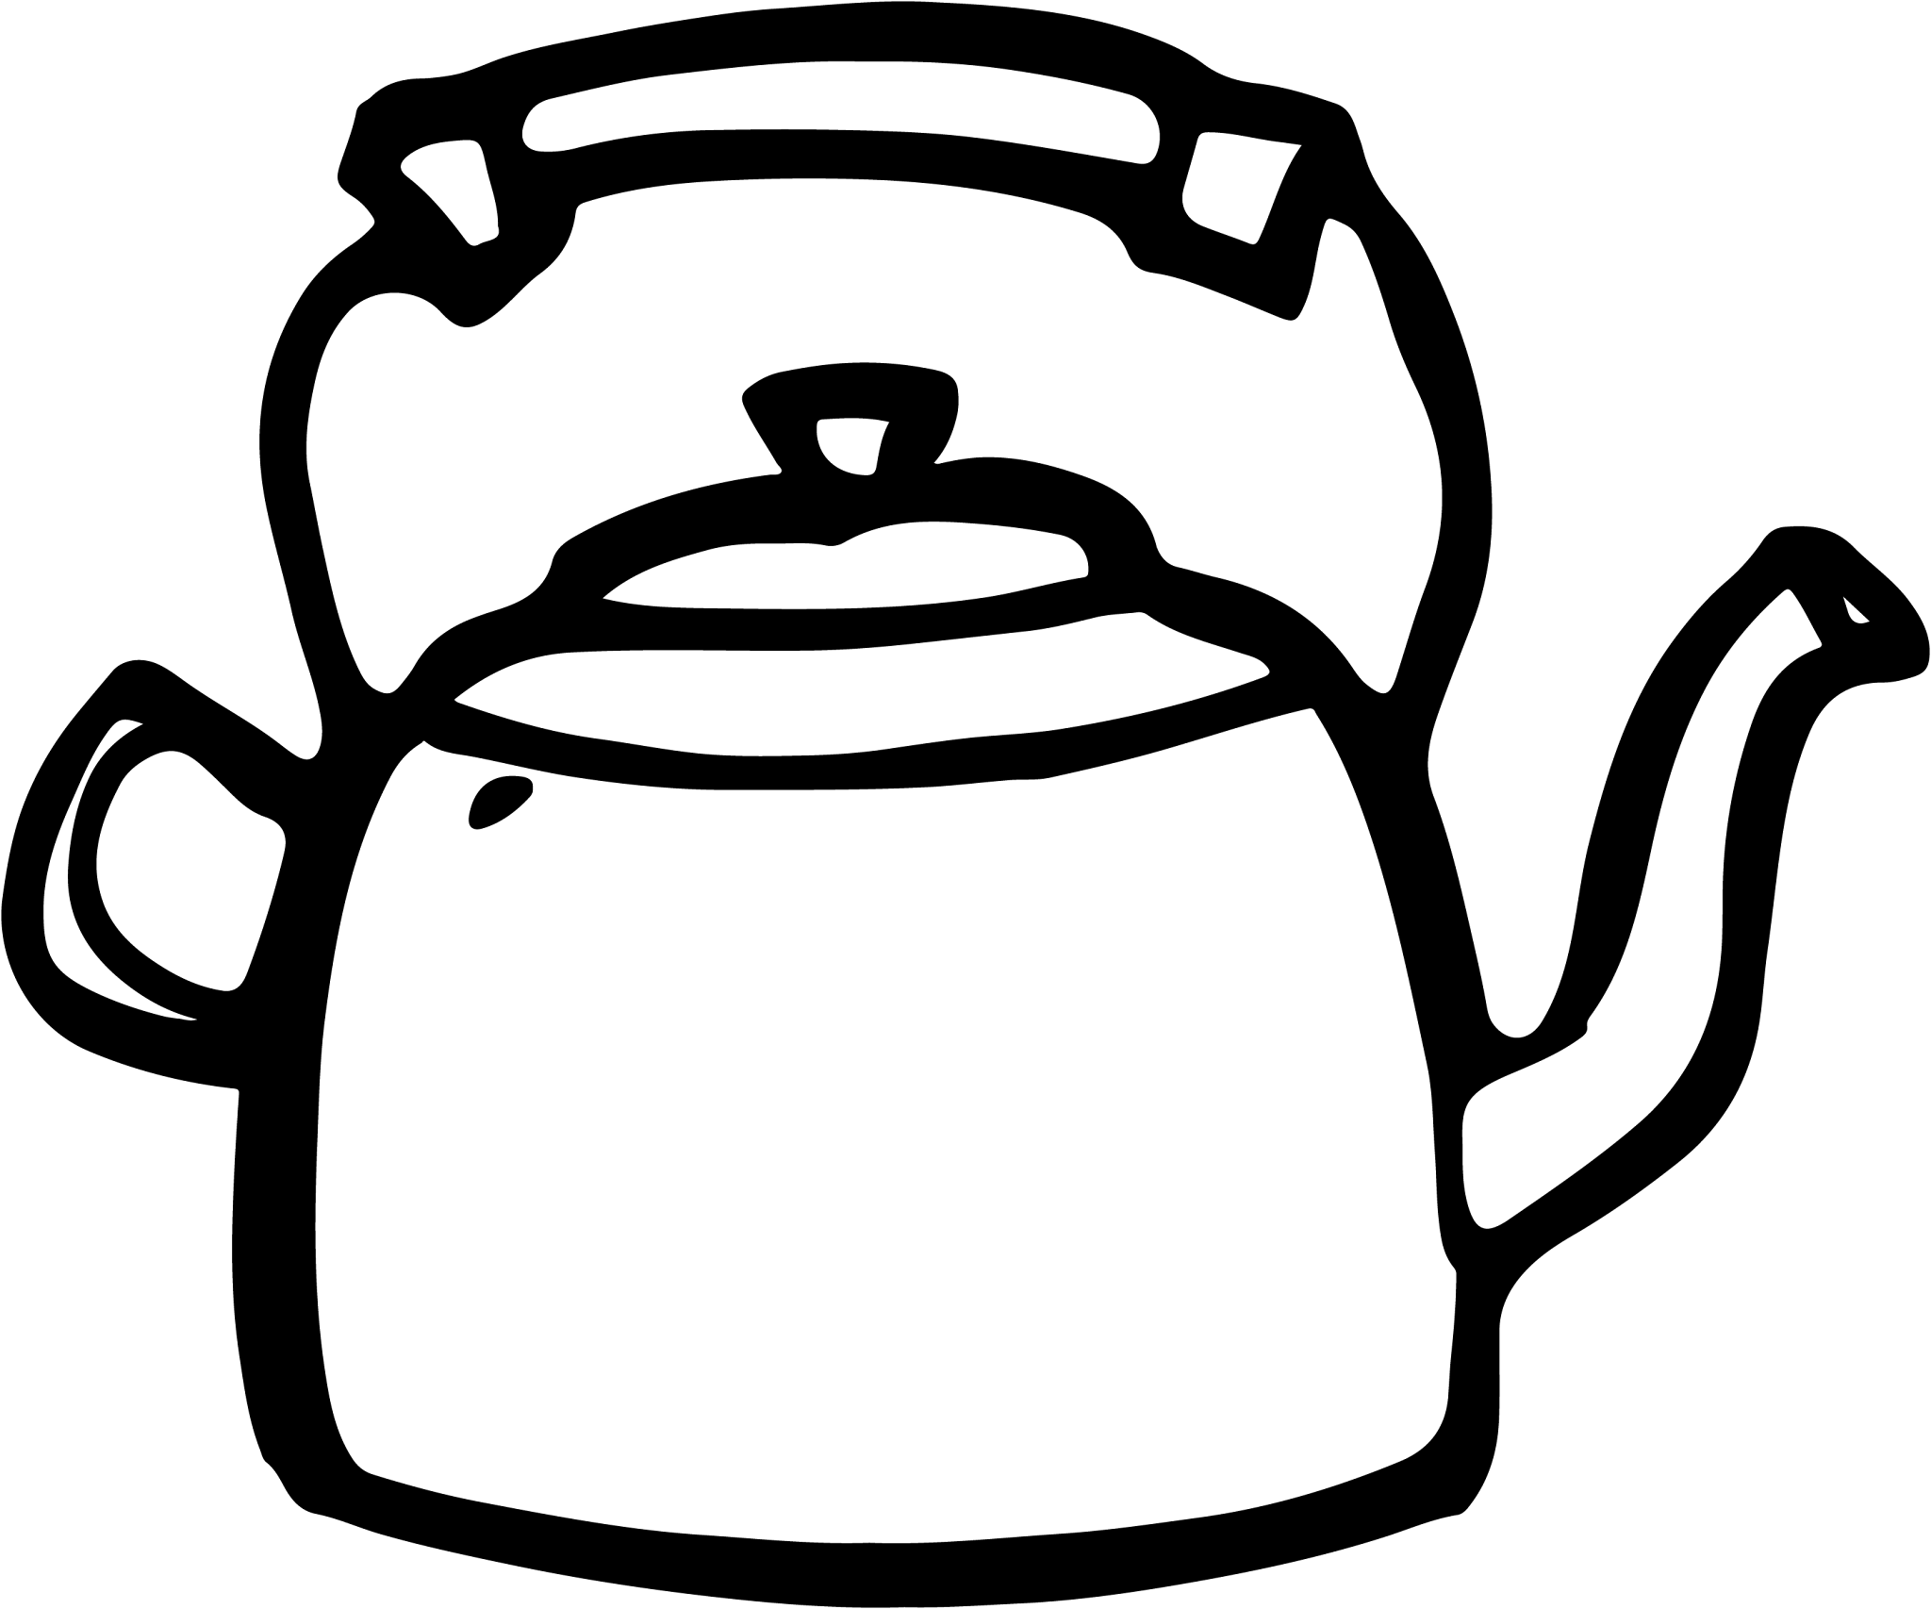
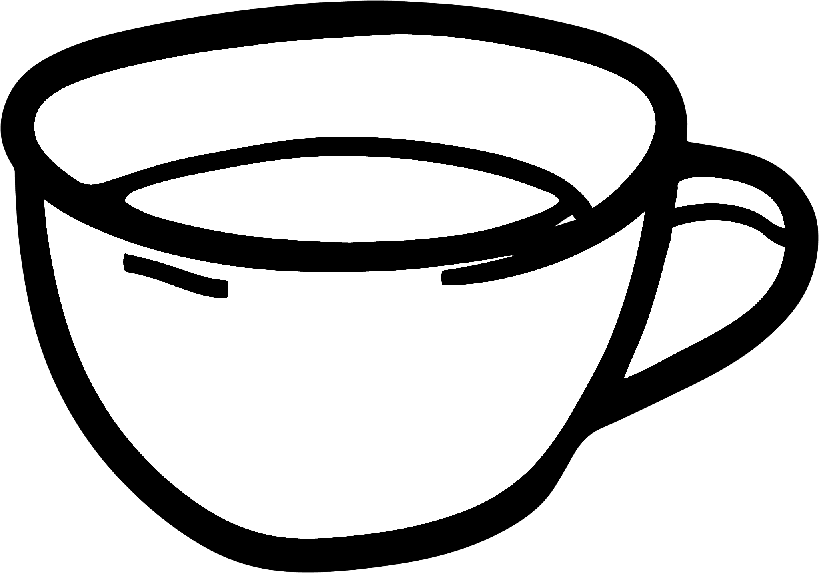
Use conversion to compare different measures
Can the kettle fully fill all four of the cups?
This kettle has a capacity of of 1.85 litres
ml means litre.
Converting 1.85 litres into ml will avoid decimals.
Each cup has a capacity of 400 ml
1000 lots of 1.85 is 1850 ml.
4 × 400ml = 1600 ml
The kettle has a capacity of 1850 ml.
The kettle has a bigger capacity than four cups, so it can fill them all.

Slide 22
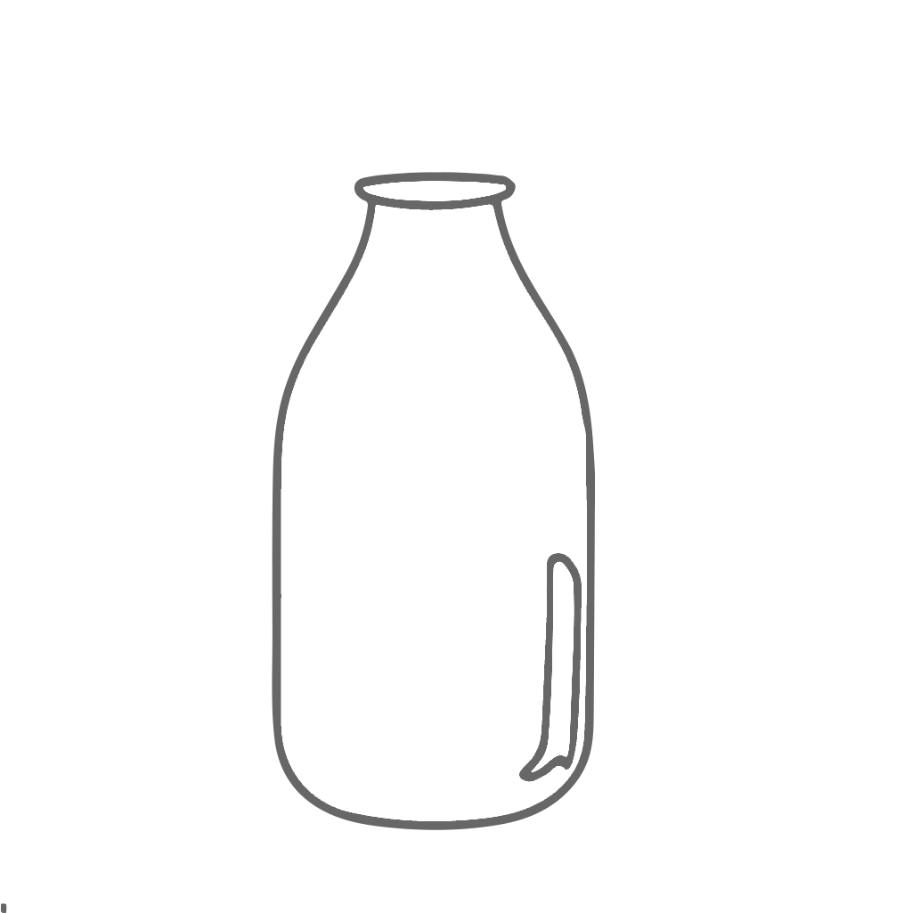
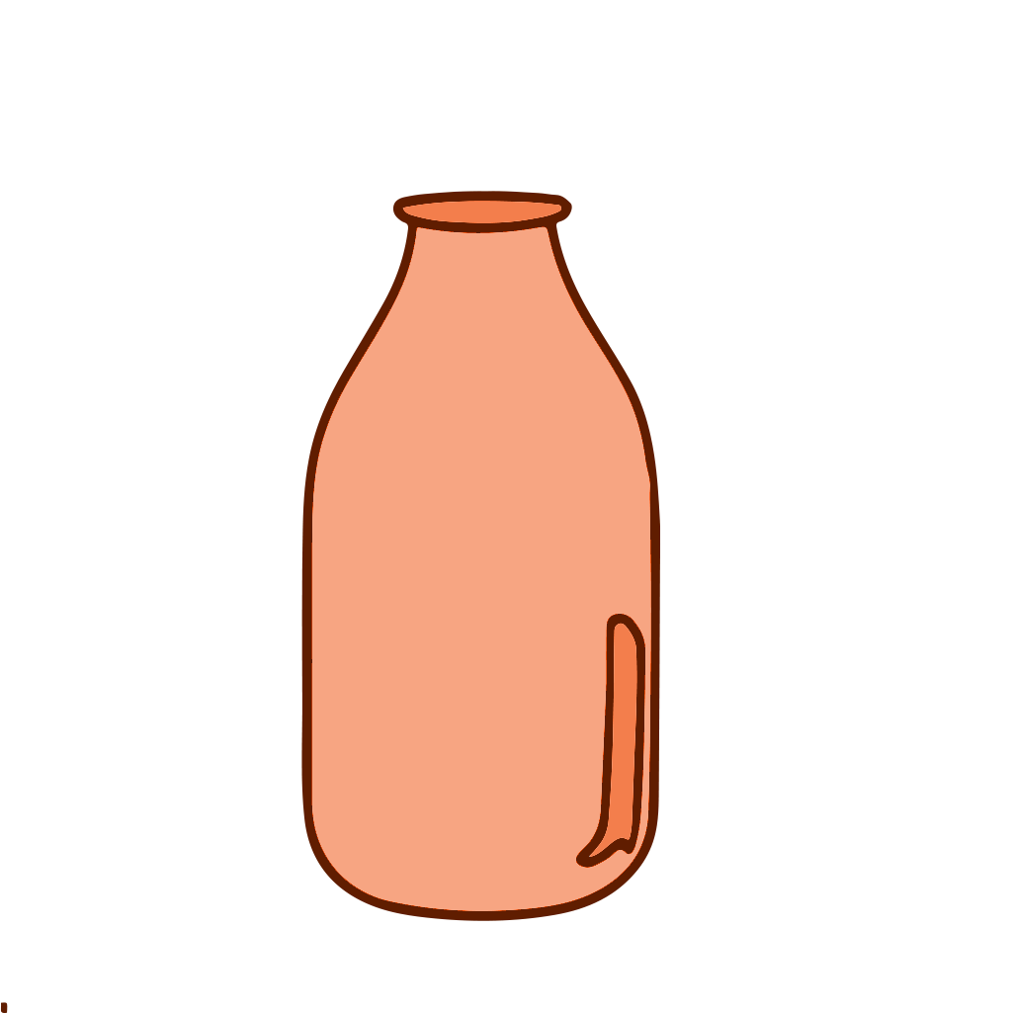
Use conversion to compare different measures
Which bottle contains the most liquid?
bottle of milk
820 ml
bottle of orange juice
0.82 litres
bottle of milk
both are equal
bottle of orange juice

Slide 23
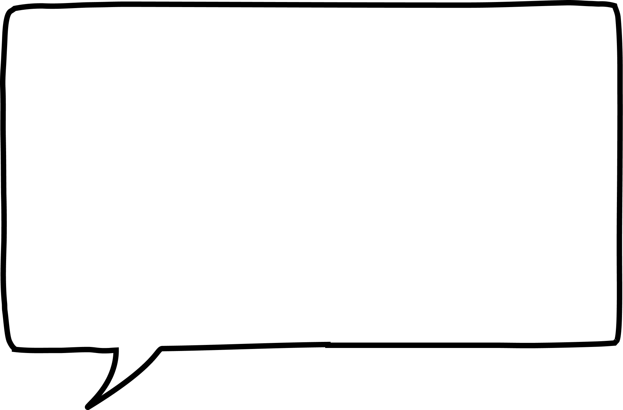
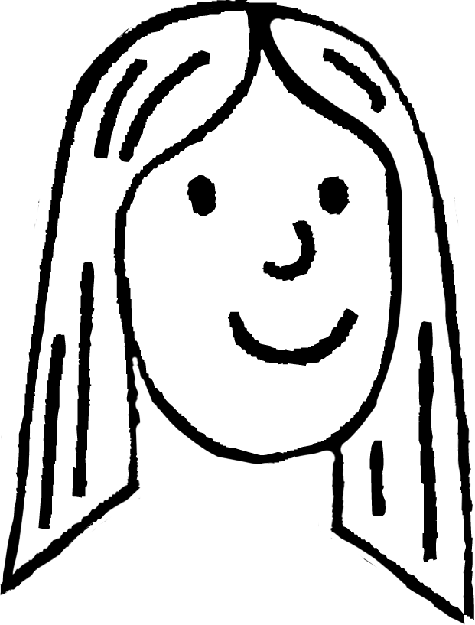
Use conversion to compare different measures
Think of three different distances that are longer than 20 m.
They all need to have different units!
What other units of distance are there?
kilometre
20 m = 0.02 km
centimetre
20 m = 2000 cm
millimetre
20 m = 20 000 mm
Laura
Example answers …
0.03 km
2500 cm
20 001 mm

Slide 24
Use conversion to compare different measures
Select all of the capacities that are bigger than 1.04 litres.
10.5 ml
105 ml
1005 ml
1050 ml

Slide 25
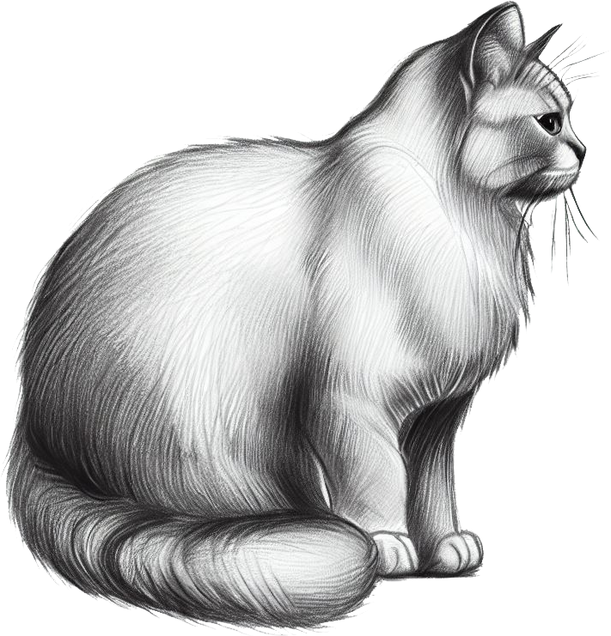
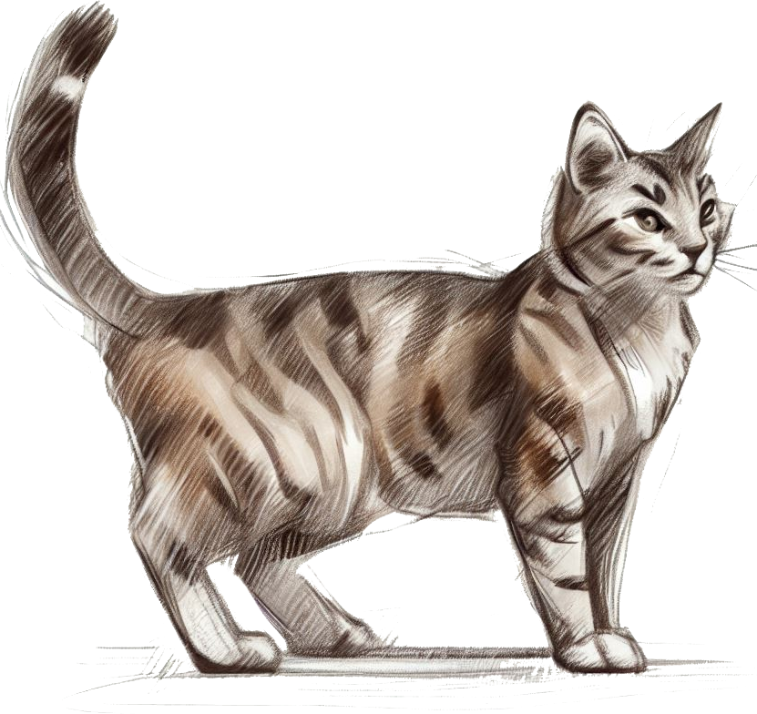
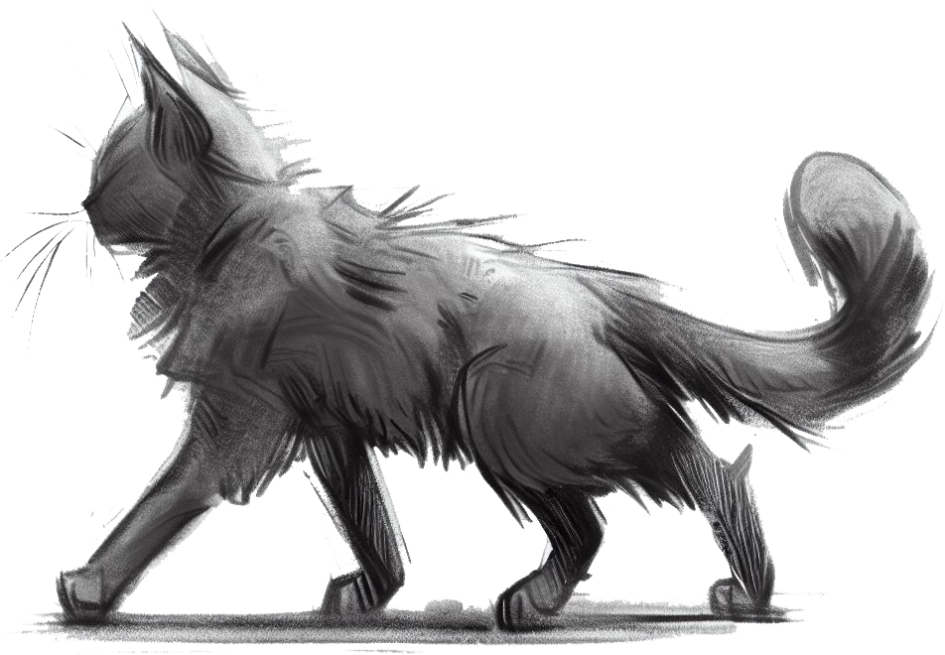
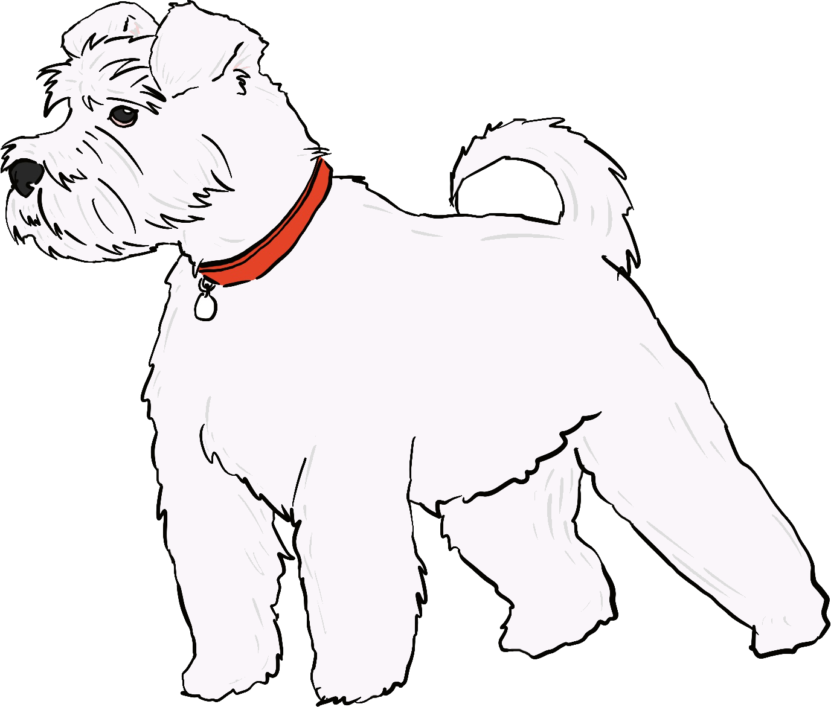
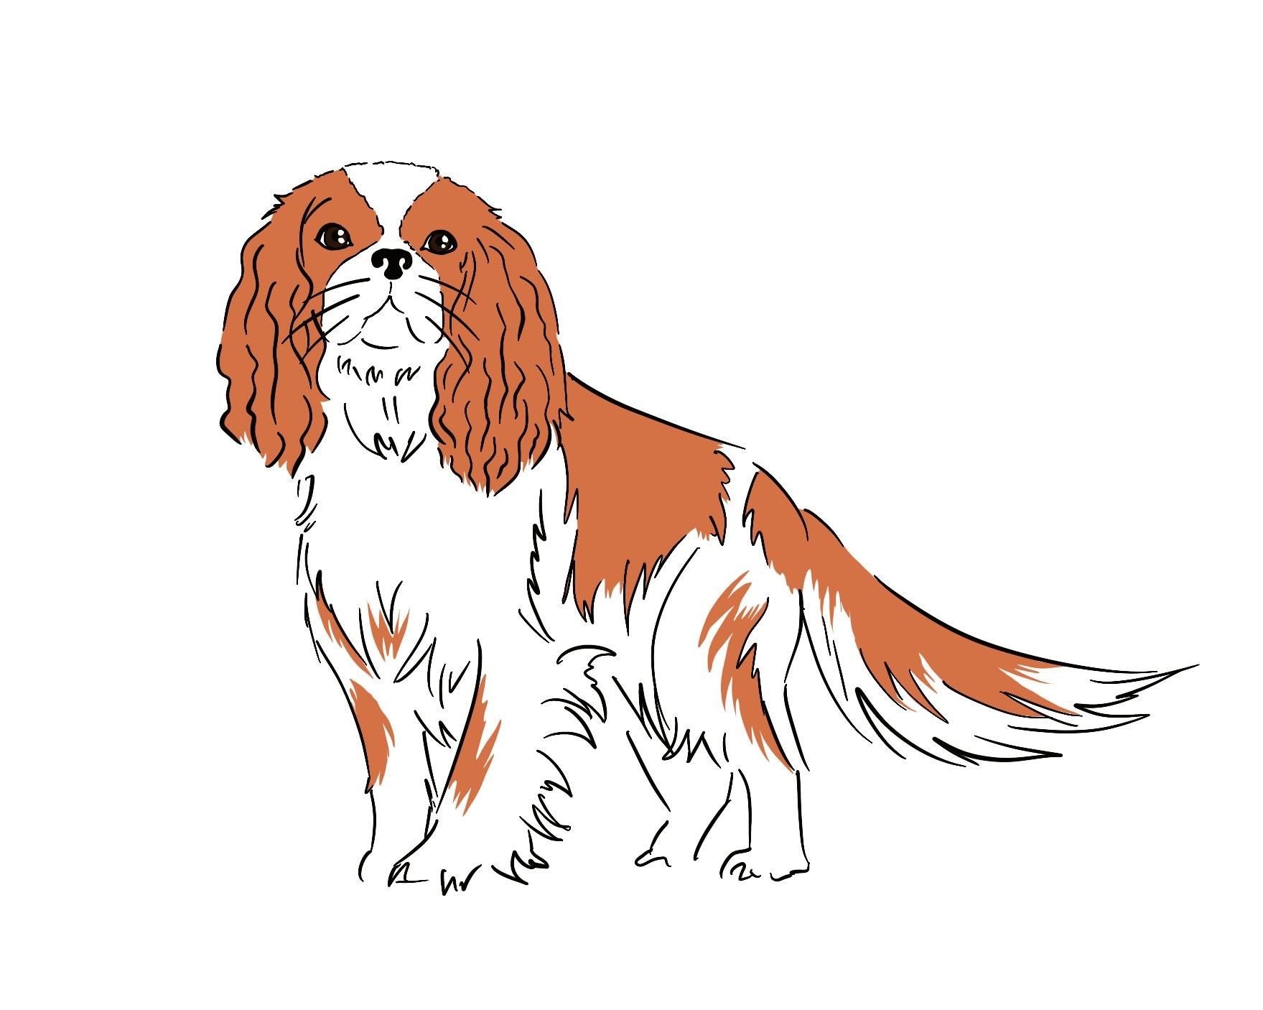
107 cm
1009 mm
1.06 m
6500 g
7 kg
Use conversion to compare different measures
1) Which of these cats is the longest?
2) Which of these dogs has a greater mass?

Slide 26
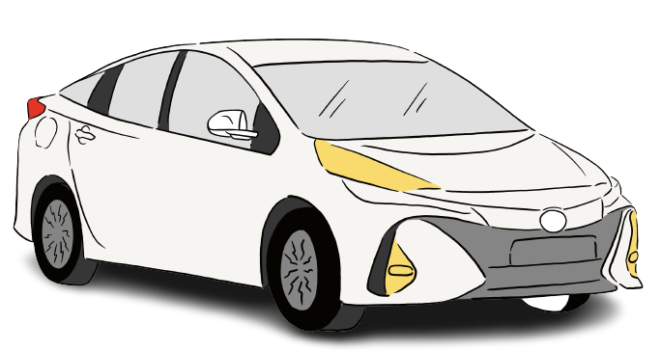
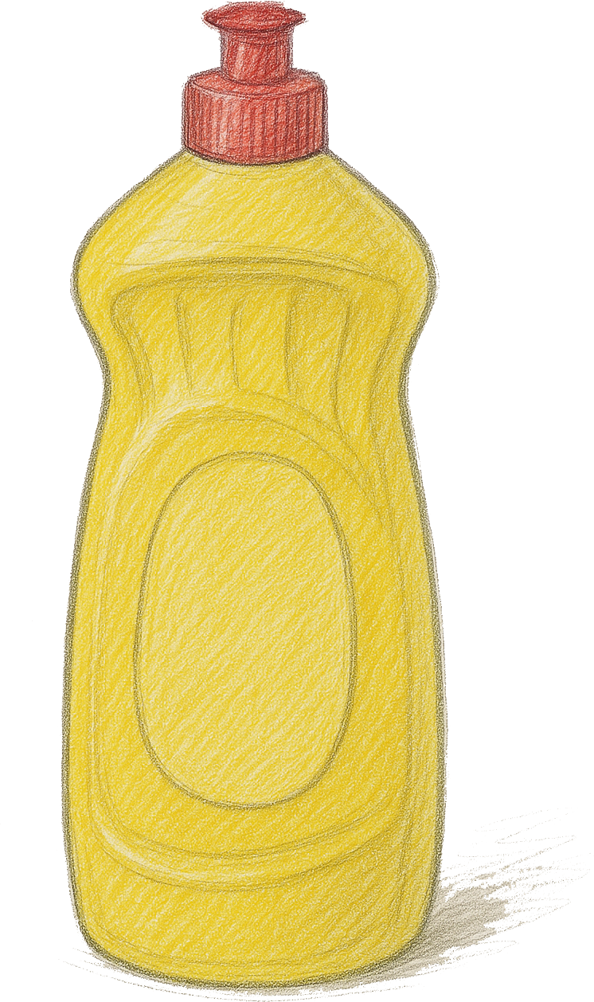
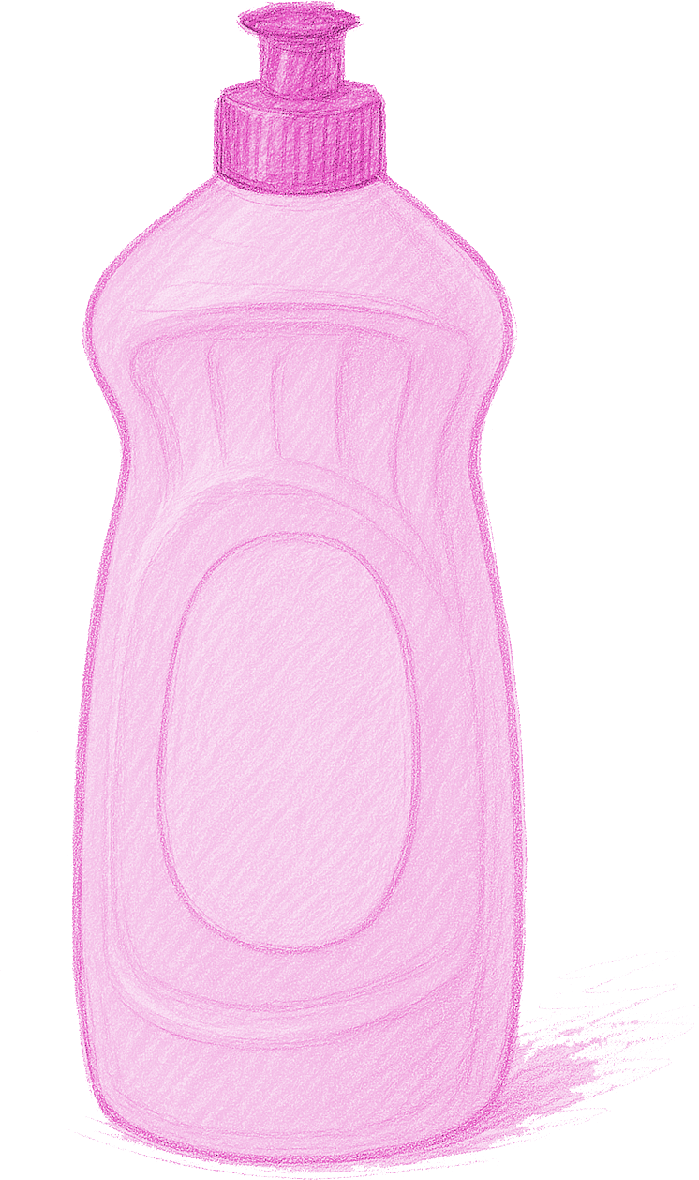
2300 kg
1.3
litres
ml
Use conversion to compare different measures
3) The 1.3 litre bottle has a larger capacity. What number could go onto the smaller bottle?
4) A different car has a greater mass than this car.
Write down a possible mass for this other car in grams.

Slide 27
1.8 km
7500 cm
180 m
75 mm
75 m
1.8 cm
Use conversion to compare different measures
5) Place these distances in order of size, smallest first.
a
b
c
d
e
f

Slide 28
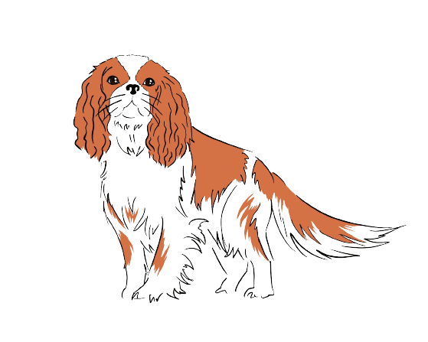
This cat is the longest.
6500 g
7 kg
6500 g
7000 g
107 cm
1009 mm
1.06 m
This dog has the greater mass.
1070 mm
1009 mm
1060 mm
Use conversion to compare different measures
1) Which of these cats is the longest?
2) Which of these dogs has a greater mass?

Slide 29
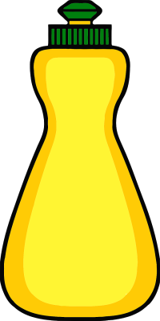
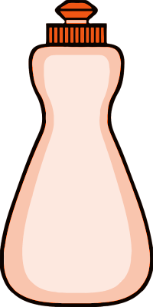
2300 kg
Any number less than 1300 ml
1.3
litres
ml
Any number greater than 2 300 000 g
Use conversion to compare different measures
3) The 1.3 litre bottle has a larger capacity. What number could go onto the smaller bottle?
4) A different car has a greater mass than this car.
Write down a possible mass for this other car in grams.

Slide 30
1.8 km
7500 cm
180 m
75 mm
75 m
1.8 cm
1800 m
75 m
180 m
0.075 m
75 m
0.018 m
shortest
longest
Use conversion to compare different measures
5) Place these distances in order of size, smallest first.
a
b
c
d
e
f
f
d
b
c
a
e

Slide 31
Securing understanding of place value in metric units
Convert metric measures using place value
Use conversion to compare different measures
Check if conversions of real examples are sensible

Slide 32
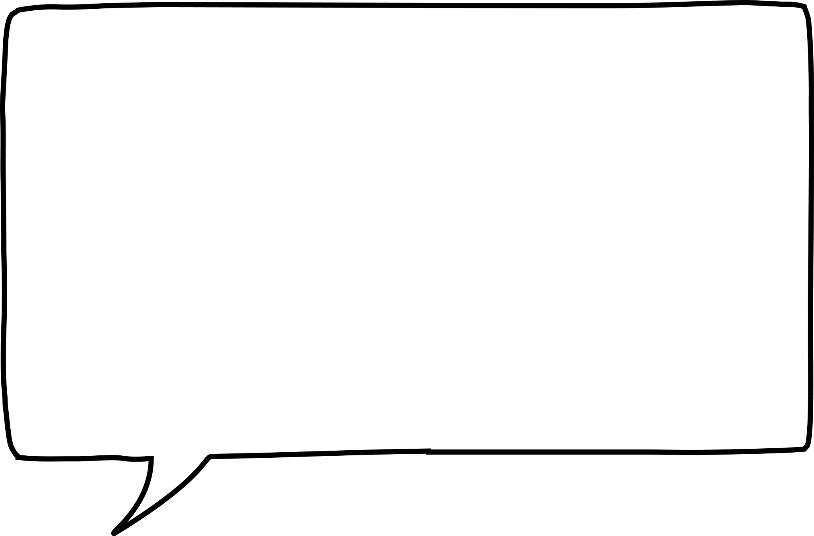
Check if conversions of real examples are sensible
My mum drove 16 km to work today.
I think that’s 160 m!
Is Jun’s statement correct?
Can you explain why?
16 km = 16 000 m
Jun
Jun is not correct. 16 km is equal to 16 000 m, not 160 m.
How should Jun have known that 160 m wasn’t a sensible answer?
160 m is too short a distance to drive to work!

Slide 33
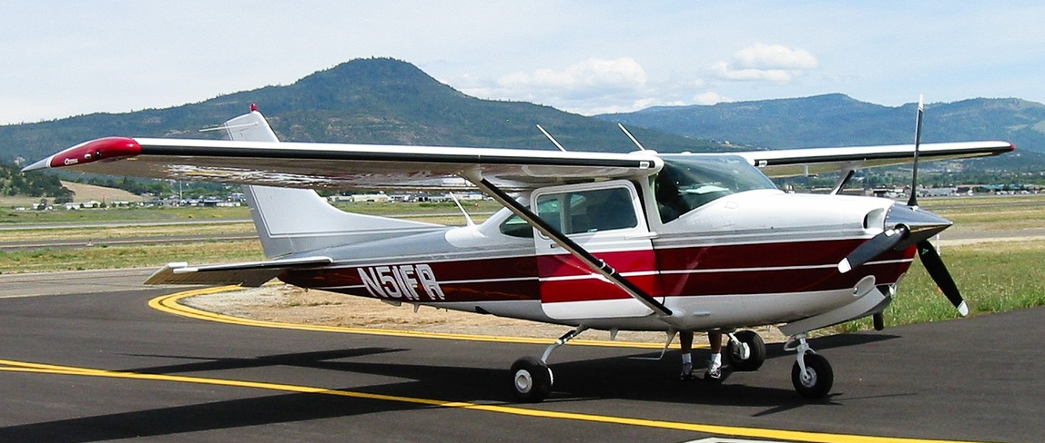
Check if conversions of real examples are sensible
This small aircraft is 13 m long.
This is the same as 13 000 .
km
cm
mm
none are correct

Slide 34
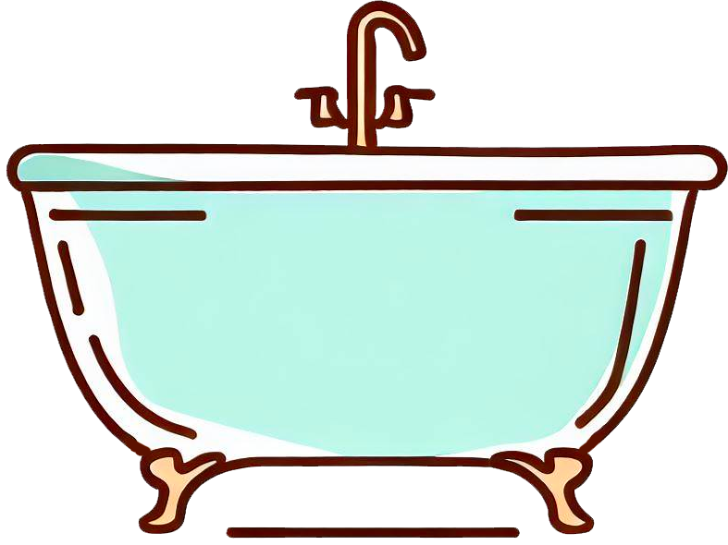
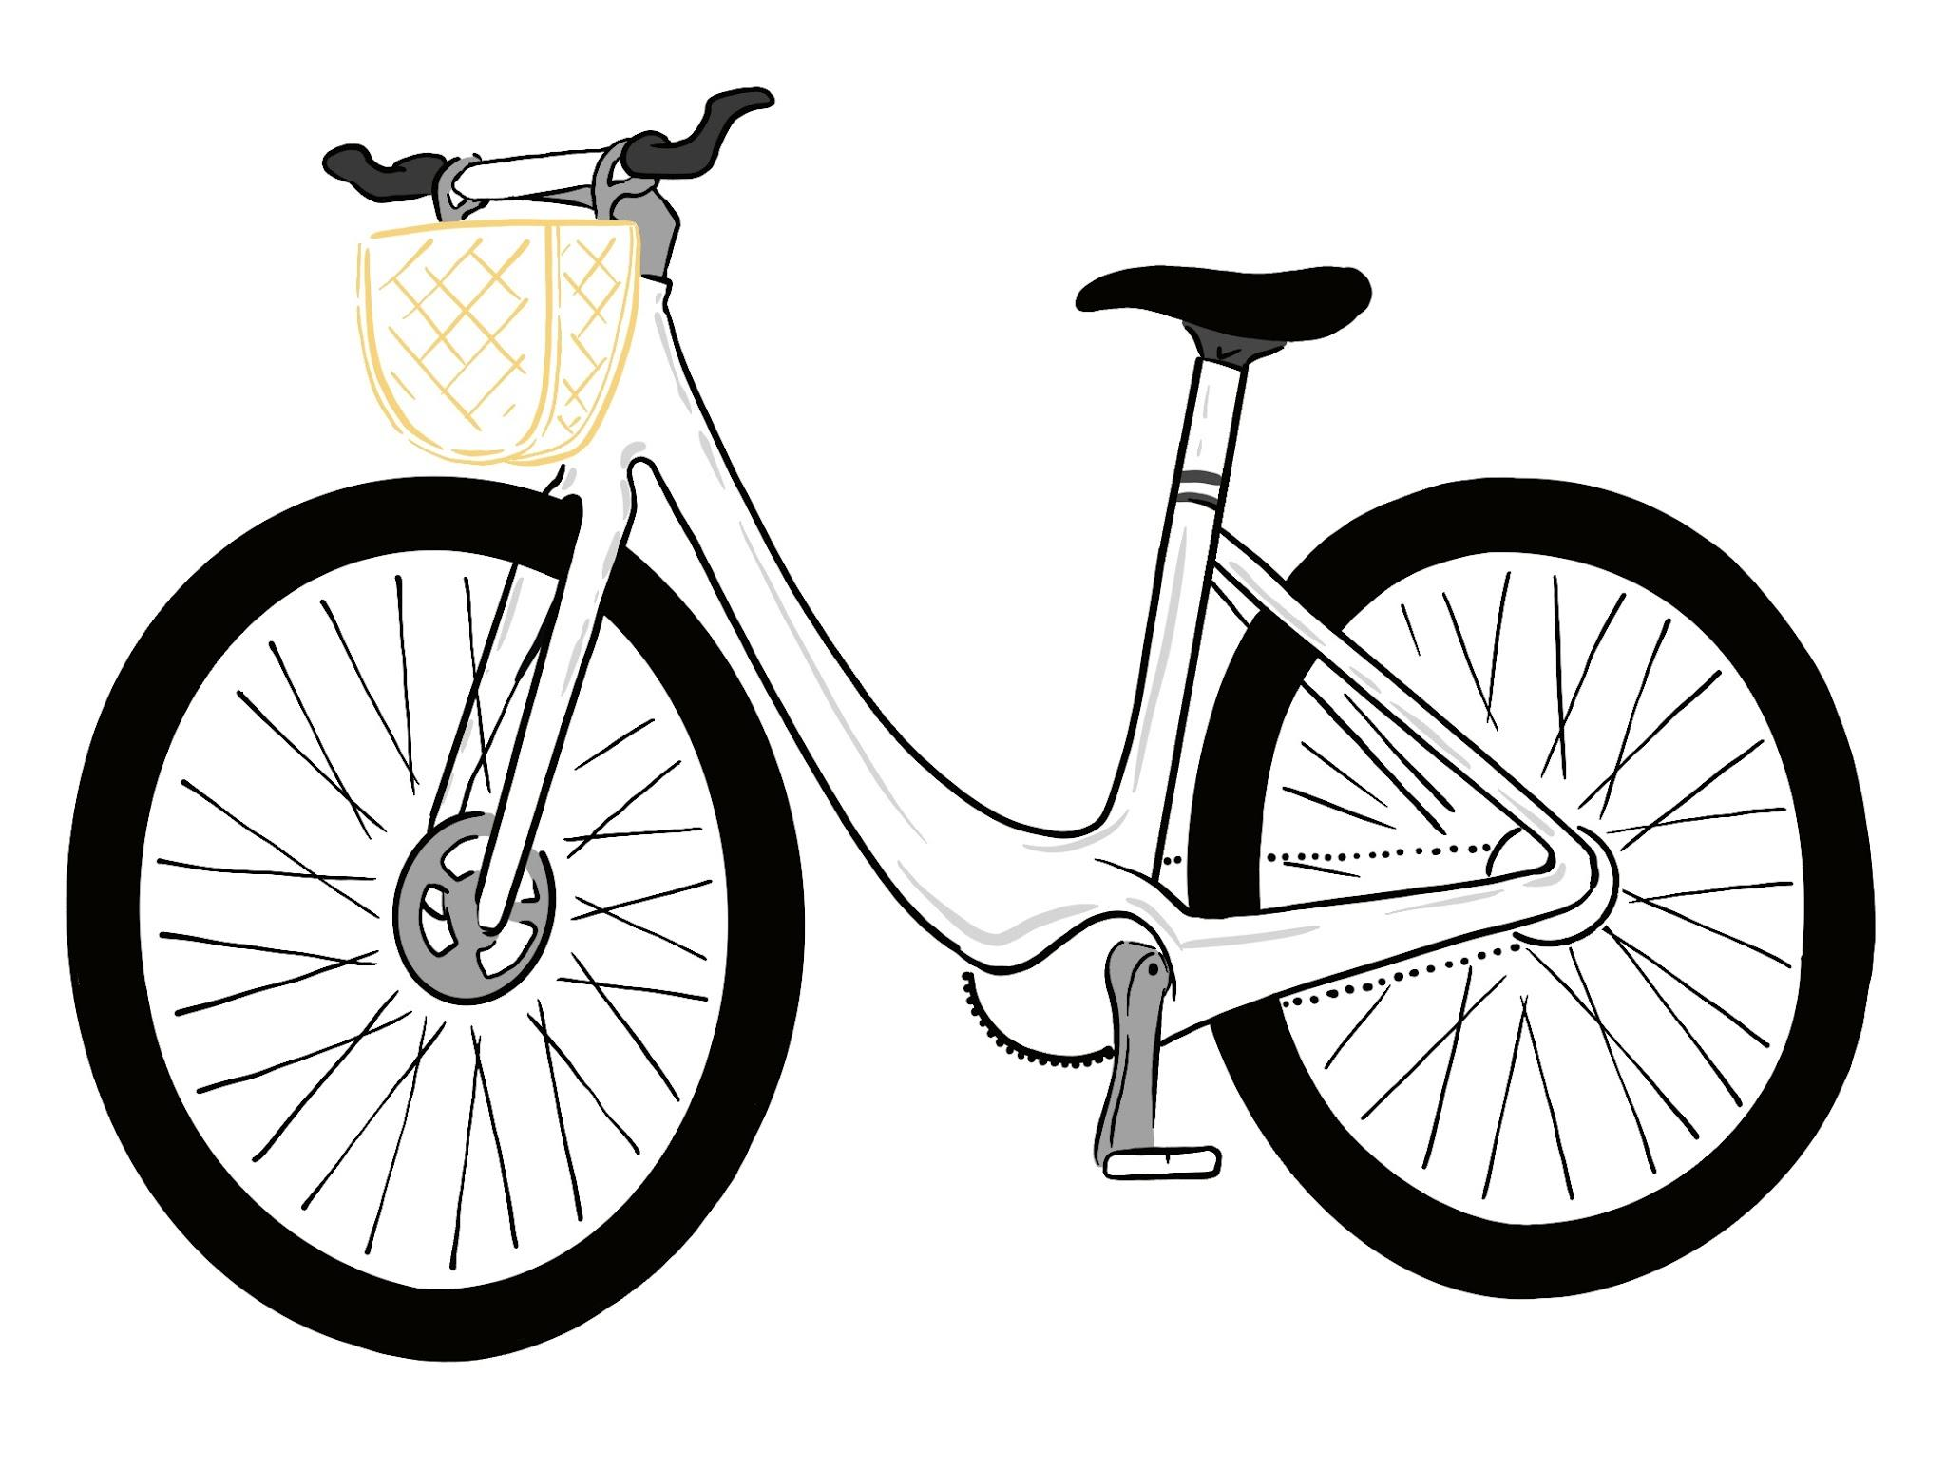
Check if conversions of real examples are sensible
1) The mass of the bike below is 14 570 g.
Which of the values below also represents this bike?
2) The capacity of this bathtub when full is 182 000 ml.
Which of the values below also represents the bathtub?
1.457 kg
18 200 litres
18 200 cl
14.57 kg
182 litres
182 cl
145.7 kg
18.2 litres

Slide 35
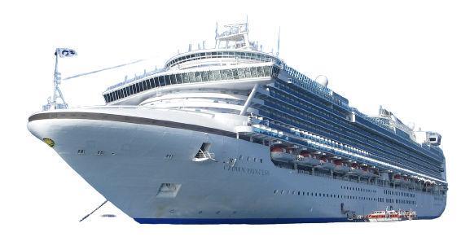
Check if conversions of real examples are sensible
3) This ship is 0.29 km long and has a mass of 113 000 000 kg.
Fill in the blanks below with the correct numbers and metric units.
290
29 000
g

Slide 36
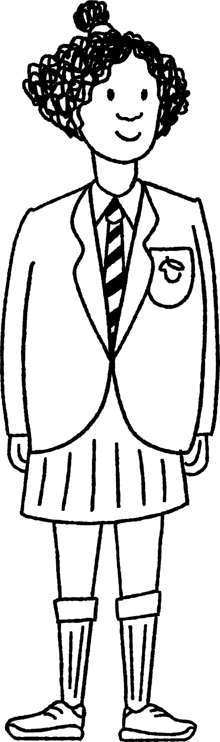
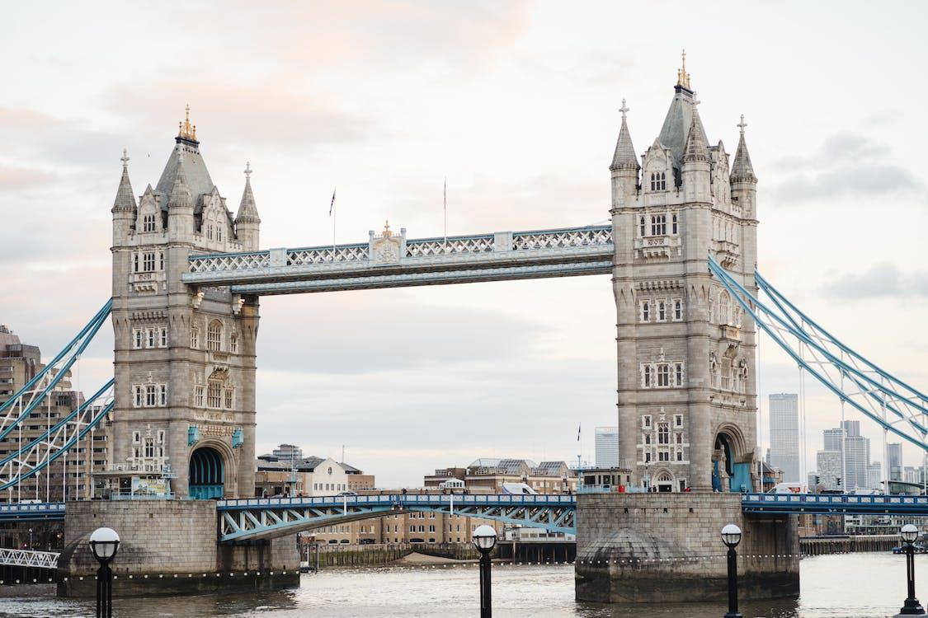
Check if conversions of real examples are sensible
4) Write down all the possible units of measure that could go in the blanks to make the descriptions underneath correct.
4) Write down all the possible units of measure that could go in the blanks to make the descriptions underneath correct.
length of Tower Bridge, London
the height of Izzy
24 400 cm
225
16.5
0.0017 km
Shorter
Longer
Shorter
Taller

Slide 37
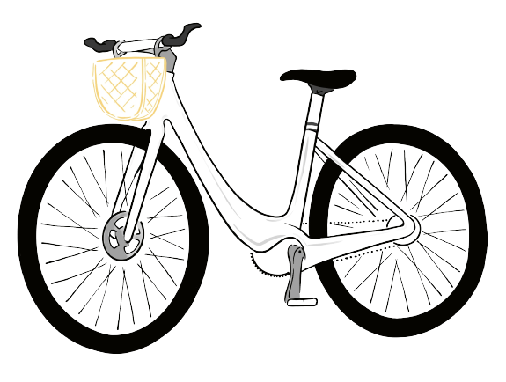
Check if conversions of real examples are sensible
1) The mass of the bike below is 14 570 g.
Which of the values below also represents this bike?
2) The capacity of this bathtub when full is 182 000 ml.
Which of the values below also represents the bathtub?
1.457 kg
18 200 litres
18 200 cl
14.57 kg
182 litres
182 cl
145.7 kg
18.2 litres

Slide 38
Check if conversions of real examples are sensible
3) This ship is 0.29 km long and has a mass of 113 000 000 kg.
Fill in the blanks below with the correct numbers and metric units.
290
m
29 000
cm
113 000 000 000
(that is 9 zeros)
g

Slide 39
Check if conversions of real examples are sensible
4) Write down all the possible units of measure that could go in the blanks to make the descriptions underneath correct.
length of Tower Bridge, London
the height of Izzy
24 400 cm
225
16.5
0.0017 km
km
cm
mm
Shorter
Longer
Shorter
Taller
244 m
1.7 m = 170 cm

Slide 40
Securing understanding of place value in metric units
Place value charts and unit prefixes can be used to help convert between different metric units.
When comparing two or more measures, it can be helpful to convert to the same unit before making a comparison.
The scale of a conversion can be checked by seeing if it makes sense in a real-world context.

Slide 41

© Oak National Academy 2023.
Produced in partnership with Mathematics in Education and Industry.
Licensed on the Open Government Licence v3.0, except where otherwise stated. See Oak terms and conditions.

